Slide 1

MODERN ANTENNAS

Slide 2


AUTOMOTIVE ANTENNAS

Slide 3


To create smoother and safer journey, connected vehicles utilize high speed mobile connection to interact with other vehicles. There comes automotive antennas to serve the purpose.
This antenna will integrate the wireless communication services in a vehicle.
They pave the way for many applications like V2V communication, V2I communication, Intelligent Transport System, Traffic management and collision avoidance.
For driver information, modern navigation system not only helps to find efficient route but also to give overview of traffic situation.

Slide 4
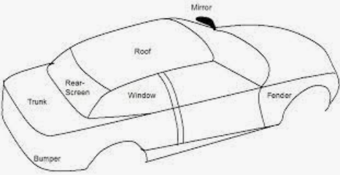
Why vehicular antennas are required?
This intelligent transport system paves the way for the vehicle to communicate with each other.
The applications in automotive industry increases day by day with enhancement in the technology integrated in the vehicles. This will completely change the way in which we interact with our vehicle.
The vehicle can be combined with more communication devices to achieve more comprehensive and intelligent driving function in future traffic systems.
Advanced Driving Assistance Systems that exist in vehicles today such as automatic parking and re-routing to avoid congestion are the building block of future solution for V2V, V2I and V2X communication.
Applications of automotive antenna
Vehicle to Vehicle communication
Vehicle to Infrastructure communication
Vehicle to X infrastructure
Intelligent Transport System
Collision avoidance
Traffic management

Slide 5
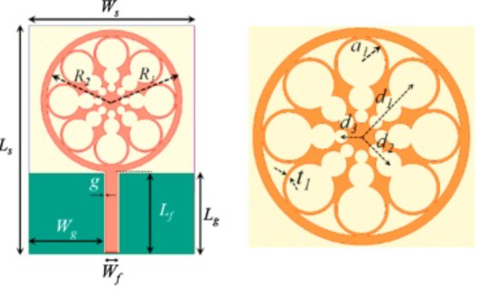
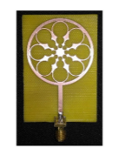
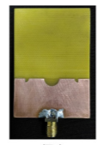
AUTOMOTIVE ANTENNAS IN LITERATURE
Transparent and conformal wheel-shaped fractal antenna for vehicular communication applications
The concept of fractal geometry is applied in this design to make the model more attractive in its appearance as well as to attain desired bands in the vehicular communication spectrum.
The proposed antenna is intended to operate in GSM-1800/1900, Digital Communication System (DCS-1800), Personal Communication Service (PCS-1900), Long-term evolution (LTE2600), Industrial, Scientific, and Medical radio band (ISM 2.4G), Wireless local area network (WLAN), Bluetooth.
Madhav, B. T. P., Anilkumar, T., & Kotamraju, S. K. (2018). Transparent and conformal wheel-shaped fractal antenna for vehicular communication applications. AEU - International Journal of Electronics and Communications, 91, 1–10
Design and study of multiband planar wheel-like fractal antenna for vehicular communication applications
In this article a multiband antenna is proposed for potential vehicular communication applications that falls under sub-6 GHz band such as IMT2000, GSM1800/1900, LTE, universal mobile telecommunication system, WLAN, dedicated short-range communication, and so on.
A conventional circular monopole radiating element is used in this design with partial ground plane.The novel defected ground structure consisting of a semi-circular slot and a pair of mirror-imaged quarter circles introduced at the top edge of the partial ground, which lies exactly beneath the microstrip line feed.
Madhav, B. T. P., & Anilkumar, T. (2018). Design and study of multiband planar wheel-like fractal antenna for vehicular communication applications. Microwave and Optical Technology Letters, 60(8), 1985–1993.

Slide 6
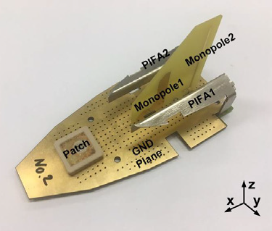
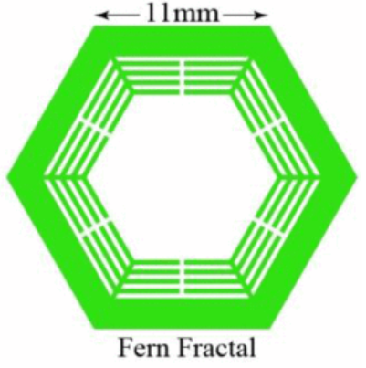
A Fully integrated Shark fin antenna for MIMO-LTE,GPS, WLAN and WAVE applications
The antenna solution is designed to fit in a shark-fin case and is easily fabricated from a printed circuit board and a metal sheet with low-cost process and materials. The antenna solution covers LTE, GPS, WLAN, and (WAVE) bands.
Modified planar monopoles are used to obtain omnidirectional radiation patterns for WLAN and WAVE bands.
Kwon, O. Y., Song, R., & Kim, B. S. (2018). A Fully Integrated Shark-Fin Antenna for MIMO-LTE, GPS, WLAN, and WAVE Applications. IEEE Antennas and Wireless Propagation Letters, 17(4), 600–603.
Compact Circularly Polarized Wide-Beamwidth Fern-Fractal-Shaped Microstrip Antenna for Vehicular Communication
A compact circularly polarized wide-beamwidth patch antenna is presented here. The proposed antenna can be used for blind spot detection in the smart vehicle. Miniaturization and beamwidth enhancement of the antenna are the main areas of discussion.
The size of the patch becomes 44% smaller than the conventional patch by folding the edge of the radiating patch with loading slots.
The proposed antenna can capture signals from a wide elevation angle and a complete azimuth range to cover the entire blind spot zone. The impedance bandwidth of the antenna is 410 MHz with 90-MHz 3-dB axial ratio bandwidth.
Mondal, T., Maity, S., Ghatak, R., & Chaudhuri, S. R. B. (2018). Compact circularly polarized wide-beamwidth fern-fractal-shaped microstrip antenna for vehicular communication. IEEE Transactions on Vehicular Technology, 67(6), 5126–5134.

Slide 7
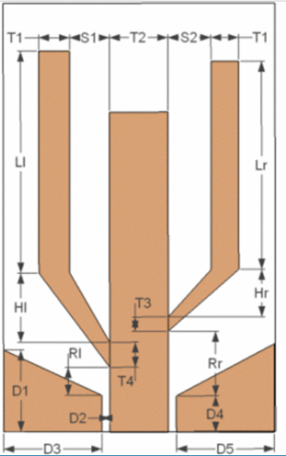
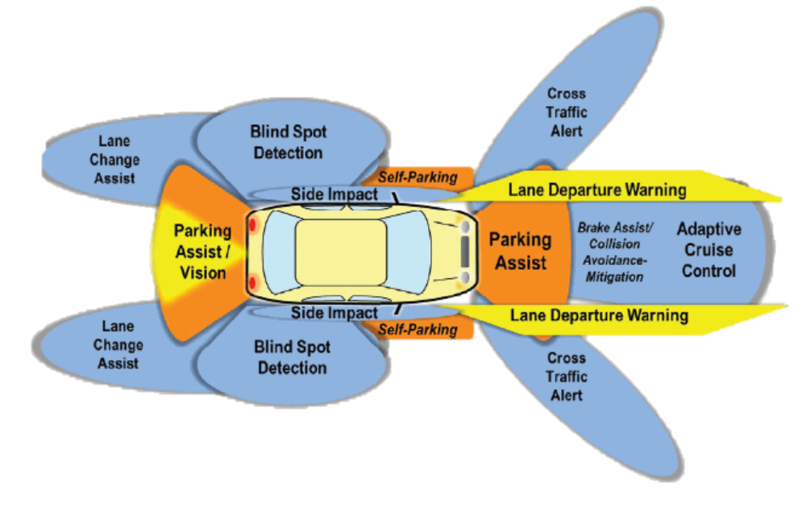
Design of a low profile multi-band antenna for vehicular communication system
A multi-band antenna fed from co-planar waveguide (CPW) was investigated and optimized for a vehicular communication system, facilitating vehicle-to-vehicle and vehicle-to-roadside communication.
The antenna covers the frequency bands 2.4 GHz and 5.4-6.0 GHz. This paper outlines the antenna optimization procedure and a design for prototyping. The prototyped antenna was measured and results were compared with a co-linear antenna and a commercial antenna, both meant for the same frequency bands.
This paper also presents simulated mutual coupling effects between antenna elements when their positions and orientations on a finite ground are varied. Such knowledge helps to introduce antenna diversity using multiple antenna elements, leading to better antenna performances in mobile environments
Gamage, J. K. H., Engjom, M., & Jensen, I. A. (2013). Design of a low profile multi-band antenna for vehicular communication system. In 2013 7th European Conference on Antennas and Propagation, EuCAP 2013 (pp. 1273–1277).
CHALLENGES
Designing of a compact antenna
Mutual coupling effect and interference from the electronic devices near by the vehicle.
To identify the location in vehicle where the antenna to be placed.
The placement of antenna should not affect the aesthetic appearance of car.

Slide 8
REFERENCES
Madhav, B. T. P., Anilkumar, T., & Kotamraju, S. K. (2018). Transparent and conformal wheel-shaped fractal antenna for vehicular communication applications. AEU - International Journal of Electronics and Communications, 91, 1–10
Madhav, B. T. P., & Anilkumar, T. (2018). Design and study of multiband planar wheel-like fractal antenna for vehicular communication applications. Microwave and Optical Technology Letters, 60(8), 1985–1993.
Kwon, O. Y., Song, R., & Kim, B. S. (2018). A Fully Integrated Shark-Fin Antenna for MIMO-LTE, GPS, WLAN, and WAVE Applications. IEEE Antennas and Wireless Propagation Letters, 17(4), 600–603
Mondal, T., Maity, S., Ghatak, R., & Chaudhuri, S. R. B. (2018). Compact circularly polarized wide-beamwidth fern-fractal-shaped microstrip antenna for vehicular communication. IEEE Transactions on Vehicular Technology, 67(6), 5126–5134.
Gamage, J. K. H., Engjom, M., & Jensen, I. A. (2013). Design of a low profile multi-band antenna for vehicular communication system. In 2013 7th European Conference on Antennas and Propagation, EuCAP 2013 (pp. 1273–1277).
A. Kumar, A. Q. Ansari, B. K. Kanaujia, J. Kishor, and S. Kumar, “An ultra-compact two-port UWB-MIMO antenna with dual band-notched characteristics,” AEU - International Journal of Electronics and Communications, vol. 114, p. 152997, 2020.
K. Srivastava, A. Kumar, B. K. Kanaujia, S. Dwari, and S. Kumar, “A CPW-fed UWB MIMO antenna with integrated GSM band and dual band notches,” International Journal of RF and Microwave Computer-Aided Engineering, vol. 29, no. 1, Oct. 2018.
Kumar,S, Lee G, Kim D, Mohyuddin W, Choi H, Kim K, “A compact four-pot UWB MIMO antenna with connected ground and wide axial ratio bandwidth” International Journal of Microwave and Wireless Technologies, 12(1), 75-85, 2020.
WuW, Yuan B,WuA, “A quad-element UWB-MIMO antenna with band-notch and reduced mutual coupling based on EBG structures”, International Journal of Antennas and Propagation, 2018.
Nguyen Khac Kiem, Huynh Nguyen Bao Phuong,and Dao Ngoc Chien, “Design of Compact 4 × 4 UWB-MIMO Antenna with WLAN Band Rejection”, International Journal of Antennas and Propagation, 2014.

Slide 9

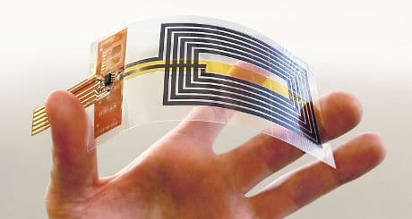
WEARABLE ANTENNA

Slide 10


The demand for wearable electronics and related technologies have grown tremendously in recent years. Some of the key developments that accelerated this growth are miniaturization of wireless devices, advent of high-speed wireless networks, availability of ultra-compact, low-power SoCs and ever-evolving battery technologies. Wearable electronics find numerous applications these days, and most of these applications use different types of antennas to sense, fetch, and exchange data wirelessly to and from a host device or an IoT gateway. Wearable Antennas are essentially any antenna that is specifically designed to function while being worn. Examples include smartwatches (which typically have integrated bluetooth antennas), glasses (such as Google Glass which has WIFI and GPS antennas). Wearable antennas are becoming increasingly common in consumer electronics, and as such this page is dedicated to describing the unique difficulties involved in wearable antenna design.

Slide 11

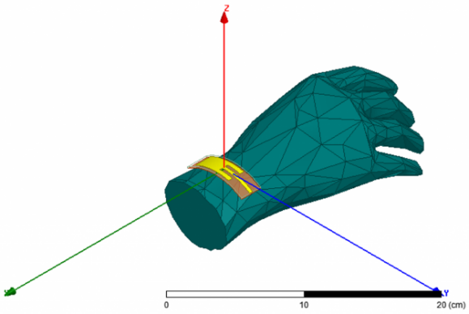
Wearable antennas are designed to function while being worn. These antennas are commonly used in wearable wireless communication and bio-medical RF systems. Wearable antennas are used within the context of Wireless Body Area Networks (WBAN).
In a WBAN, antenna is the key component that supports wireless communication, which include in-body communication, on-body communication and off-body communication.
A WBAN connects sensors, actuators and IoT nodes on human body, or on cloths or under the skin, establishing a wireless communication channel.
Wearable antennas can be employed on people of all ages, athletes and patients for a continuous monitoring of vital signs, oxygen level (Oximetry) and stress level, among others.

Slide 12
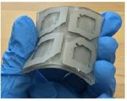
WEARABLE ANTENNAS IN LITERATURE
3-D Printing of Conformal Antennas for Diversity Wrist Worn Applications
The antennas cover 2.4 and 5.5 GHz used for WLAN communication with the reflection coefficients less than -10 dB.
Three WLAN antennas are fabricated at different positions and shape angles within the bracelet. In terms of communications systems, the advantage of this configuration is that it can increase coverage.
Simulation results of all antenna designs and studies using the finite integration technique agree well with experimental measurement results.
Jun, S. Y., Elibiary, A., Sanz-Izquierdo, B., Winchester, L., Bird, D., & McCleland, A. (2018). 3-D printing of conformal antennas for diversity wrist worn applications. IEEE Transactions on Components, Packaging and Manufacturing Technology, 8(12), 2227–2235
Compact, Highly Efficient, and Fully Flexible Circularly Polarized Antenna Enabled by Silver Nanowires for Wireless Body-Area Networks.
A compact and flexible circularly polarized (CP) wearable antenna is introduced for wireless body-area network systems at the 2.4 GHz
The circularly polarized radiation is enabled by placing a planar linearly polarized loop monopole above a finite anisotropic artificial ground plane.
By truncating the anisotropic artificial ground plane to contain only 2 by 2 unit cells, an integrated antenna with a compact form factor of 0.41λ0 × 0.41λ0 × 0.045λ0 is obtained, all while possessing an improved angular coverage of CP radiation.
Jiang, Z. H., Cui, Z., Yue, T., Zhu, Y., & Werner, D. H. (2017). Compact, Highly Efficient, and Fully Flexible Circularly Polarized Antenna Enabled by Silver Nanowires for Wireless Body-Area Networks. IEEE Transactions on Biomedical Circuits and Systems, 11(4), 920–932

Slide 13
Compact EBG-Backed Planar Monopole for BAN Wearable Applications.
A planar monopole backed with a 2 × 1 array of electromagnetic bandgap (EBG) structures for 2.45 GHz.
The reflection phase of a single EBG unit cell has been studied and exploited toward efficient radiation of a planar monopole antenna, intended for wearable applications.The proposed antenna is fabricated on a 68 × 38 × 1.57 mm3 board of semiflexible RT/duroid 5880 substrate.
The reported efficient and robust radiation performance with very low specific absorption rate, compact size, and high gain make the proposed antenna a superior candidate for most wearable applications used for off-body communication.
Abbasi, M. A. B., Nikolaou, S. S., Antoniades, M. A., Nikolić Stevanović, M., & Vryonides, P. (2017). Compact EBG-Backed Planar Monopole for BAN Wearable Applications. IEEE Transactions on Antennas and Propagation, 65(2), 453–463.
Flexible UWB organic antenna for wearable technologies application.
The proposed antenna is an elliptical monopole fed by a coplanar waveguide; it uses a kapton substrate and it is optimised to work from 1 to 8 GHz. In the case of copper, a conductive nanocomposite material based on a polymer (polyaniline: PANI) and charged by multiwalled carbon nanotubes (MWCNTs) is exploited.
The flexibility of both the kapton substrate and the nanocomposite (PANI/MWCNTs) provides the ability to crumple the antenna paving the way to potential applications for body-worn wireless communications systems
Hamouda, Z., Wojkiewicz, J. luc, Pud, A. A., Kone, L., Bergheul, S., & Lasri, T. (2018). Flexible UWB organic antenna for wearable technologies application. IET Microwaves, Antennas and Propagation, 12(2), 160–166.

Slide 14
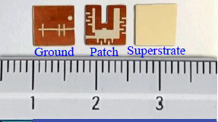
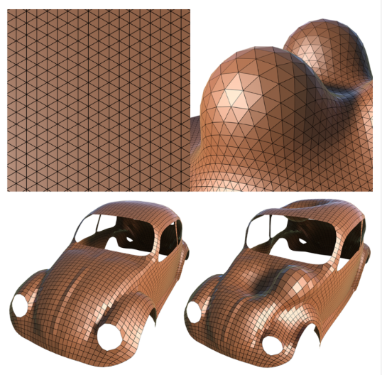
CHALLENGES
Multipath fading.
Compact and flexibility - conformal surfaces.
Suppression of mutual coupling between antennas.
Substrate selection.
Suppression of back body radiation and detuning effects.
Miniaturized Dual-Band Circularly Polarized Implantable Antenna for Capsule Endoscopic System
The study proposes a miniaturized dual-band antenna with a circular-polarization characteristic for a wireless-capsule endoscopic system operating in the industrial, scientific, and medical bands: 915 and 2450 MHz.
The proposed capsule device is intended for deep-tissue implantation with the standard dimensions of 26×11 mm2.
The circularly polarized radiator attains the AR bandwidths (BWs) of 33.0% and 8.67% and the measured-10 dB impedance BWs of 13.63% and 6.28% at 915 and 2450 MHz, respectively.
Due to the AR BW, impedance BW, and ease of fabrication, the proposed antenna system is a suitable candidate for use in endoscopic applications.
Hayat, S., Shah, S. A. A., & Yoo, H. (2021). Miniaturized Dual-Band Circularly Polarized Implantable Antenna for Capsule Endoscopic System. IEEE Transactions on Antennas and Propagation, 69(4), 1885–1895.

Slide 15
REFERENCES
Saurav, K., Mallat, N. K., & Antar, Y. M. M. (2018). A Three-Port Polarization and Pattern Diversity Ring Antenna. IEEE Antennas and Wireless Propagation Letters, 17(7), 1324–1328.
Hazarika B, Basu B, Nandi A. An artificial magnetic conductor-backed monopole antenna to obtain high gain, conformability, and lower specific absorption rate for WBAN applications. Int J RF Microw Comput Aided Eng. 2020;e22441.
Alqadami, A. S. M., Bialkowski, K. S., Mobashsher, A. T., & Abbosh, A. M. (2019). Wearable Electromagnetic Head Imaging System Using Flexible Wideband Antenna Array Based on Polymer Technology for Brain Stroke Diagnosis. IEEE Transactions on Biomedical Circuits & Systems, 13(1), 124–134.
Hamouda, Z., Wojkiewicz, J. luc, Pud, A. A., Kone, L., Bergheul, S., & Lasri, T. (2018). Flexible UWB organic antenna for wearable technologies application. IET Microwaves, Antennas and Propagation, 12(2), 160–166.
Palaniswamy, S. K., Selvam, Y. P., Alsath, M. G. N., Kanagasabai, M., Kingsly, S., & Subbaraj, S. (2017). 3-D Eight-Port Ultrawideband Antenna Array for Diversity Applications. IEEE Antennas and Wireless Propagation Letters, 16, 569–572.
Susila, M., Rao, T. R., Varshini, K., Kumar, P. S., & Pushpalatha, M. (2019). Investigations of specific absorption rate and temperature variations for an uwb antenna for wireless applications. Progress In Electromagnetics Research M, 78, 83–92.
Rizwan, M., Khan, M. W. A., Sydanheimo, L., Virkki, J., & Ukkonen, L. (2017). Flexible and Stretchable Brush-Painted Wearable Antenna on a Three-Dimensional (3-D) Printed Substrate. IEEE Antennas and Wireless Propagation Letters, 16, 3108–3112.
Jun, S. Y., Elibiary, A., Sanz-Izquierdo, B., Winchester, L., Bird, D., & McCleland, A. (2018). IEEE Transactions on Components, Packaging and Manufacturing Technology, 8(12), 2227–2235.
P. S. Taylor and J. C. Batchelor, “Finger-worn UHF far-field RFID tag antenna,” IEEE Antennas and Wireless Propagation Letters, vol. 18, no. 12, pp. 2513-2517, 2019.
L. Y. Nie, X. Q. Lin, Z. Q. Yang, J. Zhang and B. Wang, "Structure-Shared Planar UWB MIMO Antenna With High Isolation for Mobile Platform," IEEE Transactions on Antennas and Propagation, vol. 67, no. 4, pp. 2735-2738, April 2019.

Slide 16
REFLECTARRAY AND TRANSMITARRAY ANTENNA

Slide 17
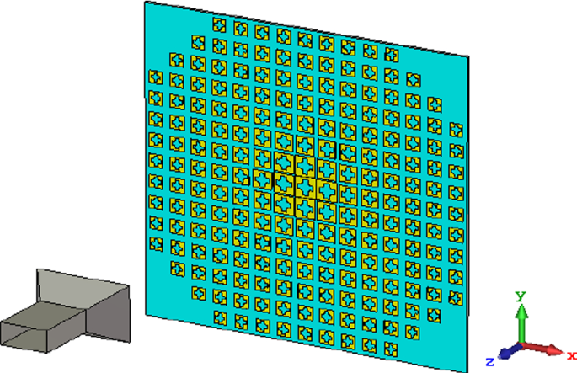
REFLECTARRAY ANTENNA
Reflectarray Antenna is a novel type of high gain antenna which consists of an array of unit cells, consisting of either a flat or a slightly curved reflecting surface illuminated by a feeding antenna. The feeding antenna is usually a horn.
Simple structure and Low cost
Ease of fabrication
Shared Aperture
Dual or multiple beam coverage
No feed network loses
Long distance communication
It is used in satellite communication, Radars, Astronomical observations etc.

Slide 18
TRANSMITARRAY ANTENNA
A high gain can be realized using two approaches:
One is based on the optic theory that manipulates the geometrical curvature of antenna surface to focus the radiation beam.
The other is the antenna array theory that controls the interference of elements radiation appropriately.
Representations for the first approach are the parabolic reflectors and lens antennas, and examples of the second approach include waveguide-slot arrays and printed microstrip antenna arrays.
As an emerging concept, the transmitarray antenna combines the favorable features of optic theory and antenna array techniques, leading to a low profile conformal design with high radiation efficiency and versatile radiation performance

Slide 19
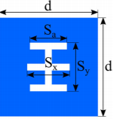
A transmitarray antenna consists of an illuminating feed source and a thin transmitting surface.
The feed source is located on an equivalent focal point. On the transmitting surface, there is an array of antenna elements.
The transmission coefficients of these elements are individually designed to convert the spherical phase front from the feed to a planar phase front. As a result, a focused radiation beam can be achieved with a high gain.
Transmitarray antennas have a great potential in many applications such as earth remote sensing, wireless communications, spatial power combining for high power applications, THz images and sensors, and solar energy concentrator.

Slide 20
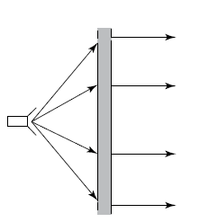
WHY RAA & TAA?
For Long distance communication we need High Gain Antennas (HGAs).
Some of the traditional HGAs are
Parabolic Reflectors
Lens Antenna
Phased array antenna.
Shortcomings of the traditional HGAs are
Complex
Costly fabrication processes
Complicated feed networks.
For long distance communications
Need of Antennas with low profile
Low loss
Low production cost
Spatially fed printed planar array is a replacement for the traditional HGAs
Reflectarray (RA)
Transmitarray (TA)

Slide 21
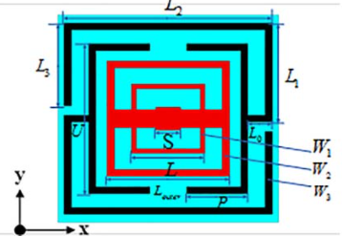
SINGLE-LAYER DUAL-BAND WIDE BAND-RATIO REFLECTARRAY WITH ORTHOGONAL LINEAR POLARIZATION
Single Layer
Dual Band (X Band & K Band)
A split square loop with two square shaped phase delay line is used for dual band operation.
By changing the structural parameter value of the element, the reflection phase shift is obtained.
Gain obtained is 23.6 dBi (10 GHz) and 30.6 dBi (22 GHz).
Aperture efficiency obtained is 48% (X Band) and 43% (K band).
Reference: Li, Xi, and Lin Yang. "Single-layer dual-band wide band-ratio reflectarray with orthogonal linear polarization." IEEE Access 8 (2020): 93586-93593.

Slide 22
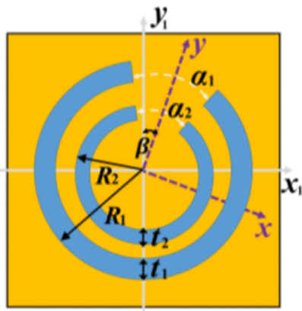
Single-Layer Reflectarray Antenna with Independent Dual-CP Beam Control
Single layer
Dual circular polarization
A single-layer nested split ring element has been designed for dual circular polarization.
By combining the variable-size approach and the element rotation approach together the desired phase shift for LHCP and RHCP waves is obtained.
Gain- 35.5 dBi with an aperture efficiency of 52.7% for LHCP excitation and a gain of 35.4 dBi and aperture efficiency of 51.6% for RHCP excitation is obtained.
Reference: Su, Tao, Xiangjie Yi, and Bian Wu. "X/Ku dual-band single-layer reflectarray antenna." IEEE Antennas and Wireless Propagation Letters 18.2 (2019): 338-342.

Slide 23
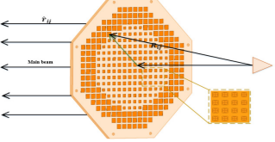
WIDEBAND LOW-PROFILE KU-BAND TRANSMITARRAY ANTENNA
Three Layers
Operating in Ku-band (15 GHz)
Square patches are printed on the substrate of the top and bottom layers, and the middle layer is a Jerusalem slot in the ground.
The 360◦ phase is achieved by changing the length of the patch and slot, and the proposed transmitarray unit has a flat phase curve and great transmission characteristics.
Gain is 23.06dBi, 42.3% aperture efficiency, the backward radiation level is below -15dB.
TA unit has symmetrical structure, so the transmitarray antenna can work in dual linear polarization or dual circular polarization.
Reference: Li, Mei-Yu, Yong-Ling Ban, and Fu-Qiang Yan. "Wideband Low-Profile Ku-Band Transmitarray Antenna." IEEE Access 9 (2020): 6683-6688.

Slide 24
REFERENCE
Li, Xi, and Lin Yang. "Single-layer dual-band wide band-ratio reflectarray with orthogonal linear polarization." IEEE Access 8 (2020): 93586-93593.
Zhang, Xingliang, et al. "Single-layer reflectarray antenna with independent dual-CP beam control." IEEE Antennas and Wireless Propagation Letters 19.4 (2020): 532-536.
Su, Tao, Xiangjie Yi, and Bian Wu. "X/Ku dual-band single-layer reflectarray antenna." IEEE Antennas and Wireless Propagation Letters 18.2 (2019): 338-342.
Veluchamy, Lingasamy, M. Gulam Nabi Alsath, and Krishnasamy T. Selvan. "Design and evaluation of a wideband reflectarray antenna using cross dipole with double‐ring elements." International Journal of RF and Microwave Computer‐Aided Engineering 29.9 (2019): e21865.
Veluchamy, Lingasamy, et al. "A wideband, single layer reflectarray antenna with cross loop and square ring slot loaded patch elements." International Journal of Microwave and Wireless Technologies 11.7 (2019): 703-710.
Cai, Yuan-Ming, et al. "Dual-band circularly polarized transmitarray with single linearly polarized feed." IEEE Transactions on Antennas and Propagation 68.6 (2020): 5015-5020.
Veljovic, Miroslav J., and Anja K. Skrivervik. "Circularly Polarized Transmitarray Antenna for CubeSat Intersatellite Links in K-Band." IEEE Antennas and Wireless Propagation Letters 19.10 (2020): 1749-1753.
Deng, Ruyuan, et al. "Single-layer dual-band reflectarray antennas with wide frequency ratios and high aperture efficiencies using phoenix elements." IEEE Transactions on Antennas and Propagation 65.2 (2016): 612-622.
Xu, Hongjing, et al. "Design and Experiment of a Dual-Band 1 Bit Reconfigurable Reflectarray Antenna With Independent Large-Angle Beam Scanning Capability." IEEE Antennas and Wireless Propagation Letters 19.11 (2020): 1896-1900.
Li, Mei-Yu, Yong-Ling Ban, and Fu-Qiang Yan. "Wideband Low-Profile Ku-Band Transmitarray Antenna." IEEE Access 9 (2020): 6683-6688.

Slide 25
Antennas for Non-destructive Testing

Slide 26

Antennas for Non-destructive Testing
Non-destructive testing (NDT)
Determining the characteristics of the target system under test without hindering or compromising its utility or usefulness
Traditional methods of NDT
Ultrasound, eddy current, stereography, magnetic particle testing, dye penetrant, visual testing, and radiography.
Application domains
Infrastructure, oil gas pipelines, aerospace maintenance repair and overhaul (MRO) for detection and imaging of defects and ensuring the structural health of the target under test.
Why UWB for NDT Applications..?
It can operate in both l;ow and high frequency range giving the unique features like:
Ability to penetrate obstacles, Higher precision range and multipath resolving capacity, Low EM radiation of -41.3 dB, Low energy consumption

Slide 27
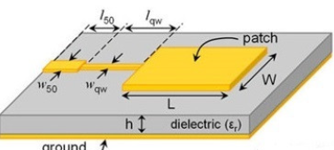
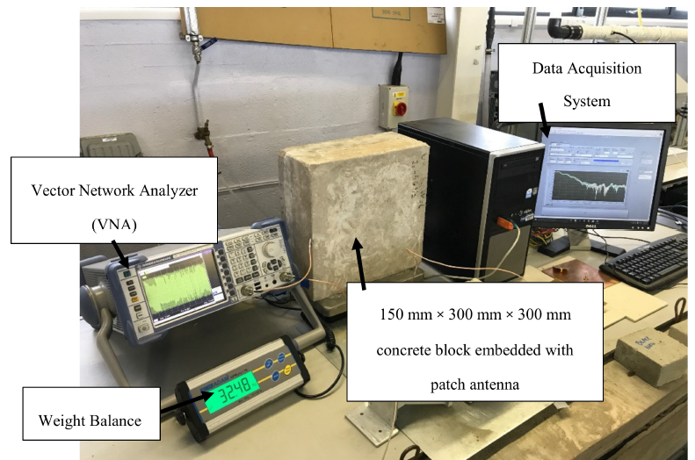
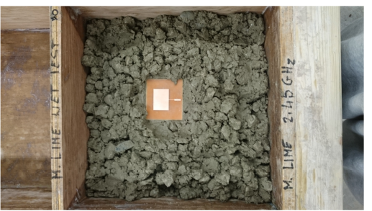
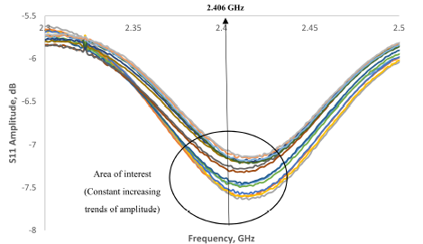
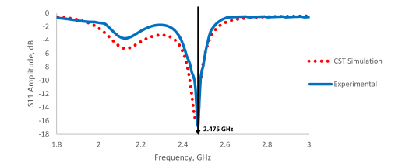
Detection of Moisture Content and Deterioration in Concrete
An Electromagnetic (EM) sensor was designed and embedded inside the concrete to detect the moisture content within the structure.
Dimensions:60 mm×60 mm
Substrate:FR-4(loss free, ɛ_{r}=4.7)
At the frequency of 2.4 GHz, the signal spectrum shifts from 7.5 dB to 6.8 dB when the moisture content decrease.
Advantages: Minimal dependence on substrate thickness
Unipolar configuration
Quarter-wavelength transmission feed line
Reference: Kah Hou Teng 1, Patryk Kot 1,Magomed Muradov , Embedded Smart Antenna for Non-Destructive Testing and Evaluation (NDT&E) of Moisture Content and Deterioration in Concrete in Sensors/MDPI
.

Slide 28
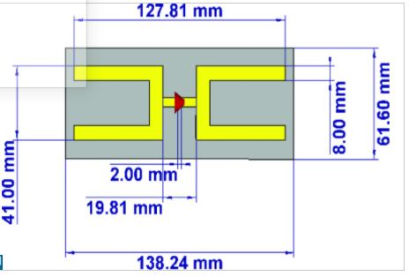
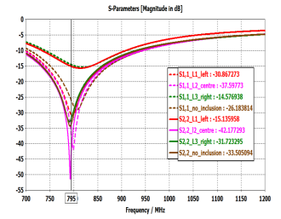
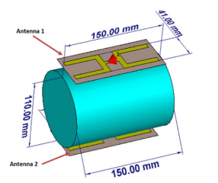
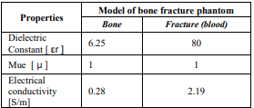
A Non-Invasive Bone Fracture Monitoring Analysis using an UHF Antenna
Dimensions: 150 mm × 110 mm
Frequency band: UHF band of 866 MHz
Model is simulated with the normal bone having a radius of 55 mm and a height of 150 mm.
Two UHF proposed antennas are used to detect the fracture by placing on the top and on the bottom side of arm structure.
For fracture monitoring, a blood-mimicking cylindrical inclusion is introduced having a radius of radius of 7.5 mm and a height of 70 mm. The inclusion is positioned at various locations of the bone structure to analyze the effect of variable.
Reference: M. Riaz, G. Tiberi, H. Asani, M. Ghavami and S. Dudley, "A Non-Invasive Bone Fracture Monitoring Analysis using an UHF Antenna," 2020 12th International Symposium on Communication Systems, Networks and Digital Signal Processing (CSNDSP), 2020, pp. 1-5, doi: 10.1109/CSNDSP49049.2020.9249570.

Slide 29
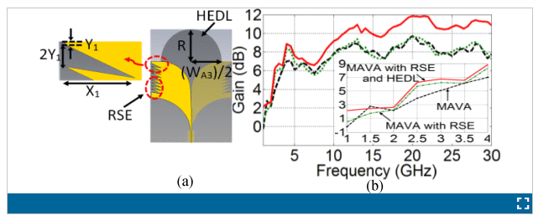
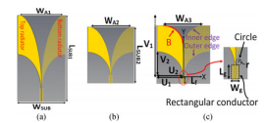
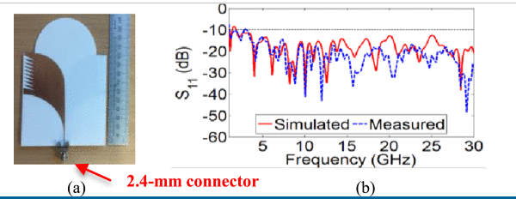
Miniaturized UWB Antipodal Vivaldi Antenna for Detection of Void Inside Concrete Specimens.
The designed Antenna will give high penetration Depth and Range resolution for getting high quality images of a lossy concrete having bandwidth from 1–3 GHz for S11 < −10 dB.
Substrate: Rogers RO4003C
Reference: M. Moosazadeh, S. Kharkovsky, J. T. Case and B. Samali, "Miniaturized UWB Antipodal Vivaldi Antenna and Its Application for Detection of Void Inside Concrete Specimens," in IEEE Antennas and Wireless Propagation Letters, vol. 16, pp. 1317-1320, 2017, doi: 10.1109/LAWP.2016.2633536.trape

Slide 30

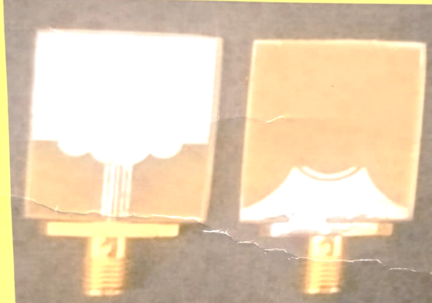
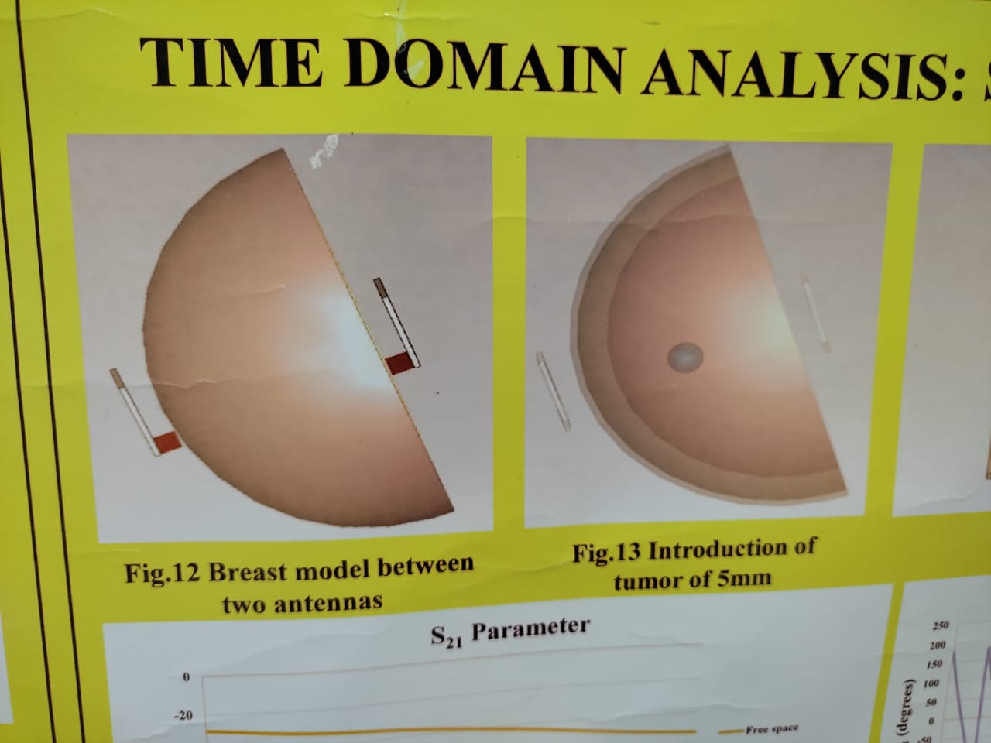
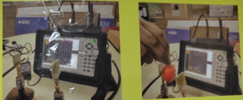
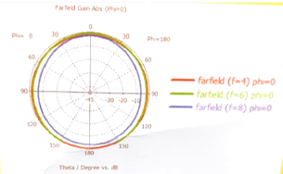
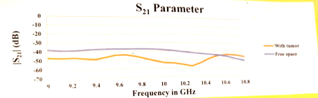
Design of Ultra-Wide Band Antenna for breast tumor detection
Design Flow
The designed antenna exhibits Omni-directional radiation pattern with the gain of 0.5 dB and total efficiency of 70.8%.
frequency range 3.1 10.6 GHz.
Substrate:
Performed SAR analysis using a single antenna
SAR Value <1.6 W/Kg for 1 gram of tissue.
3. Modelling of breast phantom
2. Fabricated Antenna:
4. Distilled water modelled as Tumor
6.Comparision of results with and without tumor
5. Radiation Pattern at 5 GHz
Reference: Kah Hou Teng 1, Patryk Kot 1,Magomed Muradov , Embedded Smart Antenna for Non-Destructive Testing and Evaluation (NDT&E) of Moisture Content and Deterioration in Concrete in Sensors/MDPI

Slide 31
References:
Velan et al., “Dual-band EBG integrated monopole antenna deploying fractal geometry for wearable applications,” IEEE Antennas and Wireless Propagation Letters, vol. 14, pp. 249-252, 2015.
V. S. Ramalingam, M. Kanagasabai and E. F. Sundarsingh, "Detection of Voids in Fiber Reinforced Plastics Using Magnetoinductive Coupled Microstrip Sensor," in IEEE Sensors Journal, vol. 15, no. 8, pp. 4182-4183, Aug. 2015, doi: 10.1109/JSEN.2015.2428813.
P. Soontornpipit, C. M. Furse and You Chung Chung, "Design of implantable microstrip antenna for communication with medical implants," in IEEE Transactions on Microwave Theory and Techniques, vol. 52, no. 8, pp. 1944-1951, Aug. 2004, doi: 10.1109/TMTT.2004.831976.
M. Riaz, G. Tiberi, H. Asani, M. Ghavami and S. Dudley, "A Non-Invasive Bone Fracture Monitoring Analysis using an UHF Antenna," 2020 12th International Symposium on Communication Systems, Networks and Digital Signal Processing (CSNDSP), 2020, pp. 1-5, doi: 10.1109/CSNDSP49049.2020.9249570.
M. Moosazadeh, S. Kharkovsky, J. T. Case and B. Samali, "Miniaturized UWB Antipodal Vivaldi Antenna and Its Application for Detection of Void Inside Concrete Specimens," in IEEE Antennas and Wireless Propagation Letters, vol. 16, pp. 1317-1320, 2017, doi: 10.1109/LAWP.2016.2633536.

